Slide 1
Science
Properties and Changes of Materials
Year One
Science | Year 5 | Properties and Changes of Materials | Keeping Cool | Lesson 2

Slide 3
Aim
I can investigate thermal conductors and insulators.
Success Criteria
I can identify materials that are thermal conductors and insulators.
I can explain what thermal conductors and insulators are.
I can plan and carry out an investigation into thermal conductors and insulators.
I can give reasons for the uses of thermal conductors and insulators.

Slide 4
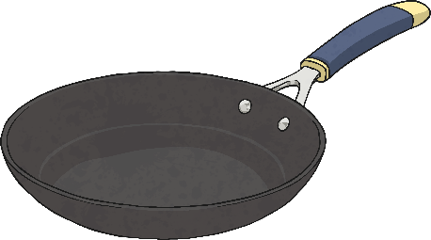
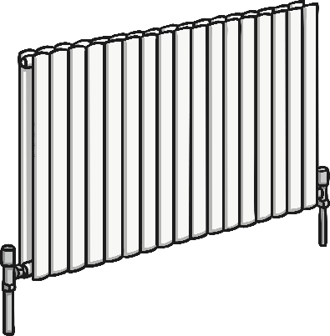
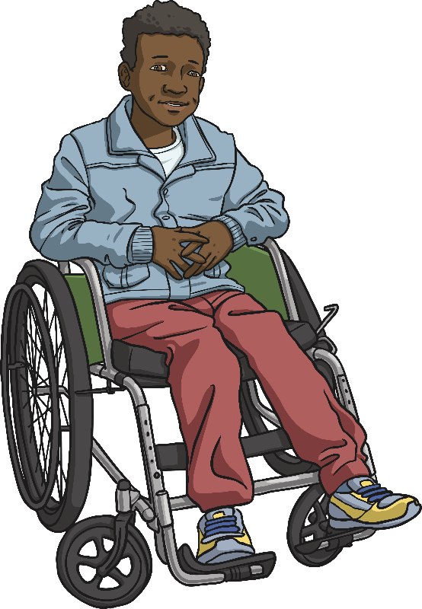
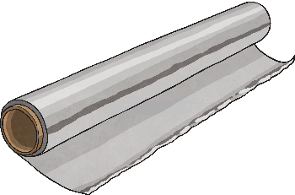
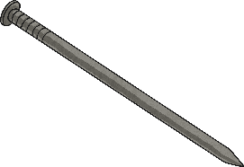
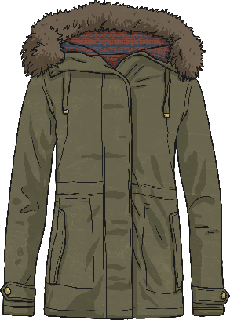
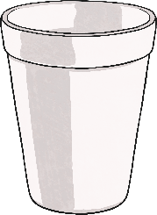
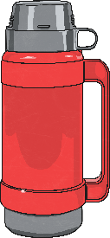
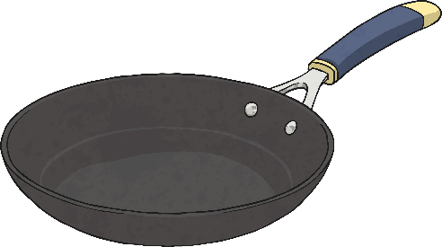
Sorting Materials
Mason has sorted these materials into two groups.
pan
pan handle

Slide 5
Sorting Materials
Can you identify the two groups that he has sorted them into?
pan
pan handle

Slide 6
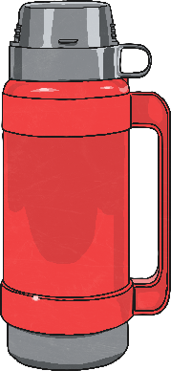
Sorting Materials
Did you figure it out?
Mason has sorted the materials into thermal conductors and insulators.
Thermal Conductors
Thermal Insulators
pan
pan handle

Slide 7
Thermal Conductors and Insulators
Thermal Conductors
Thermal Insulators
Heat can travel easily through thermal conductors.
Metals are good thermal conductors, as they allow heat to move through them.
Thermal conductors are used to make items that need heat to travel through them, like a pan or a radiator.
Thermal insulators do not let heat travel through them easily.
Some fabrics, wood and plastics are good thermal insulators.
Thermal insulators can keep heat out or in. For example, a vacuum flask stops heat from the air travelling through to the food or drink inside, keeping it cool. A coat stops the heat from your body travelling through to the air outside, keeping you warm.
Did you know?
Heat always travels from a warmer area to a cooler one.

Slide 8
Thermal Conductors and Insulators
Try this quiz to test your understanding of thermal conductors and insulators.
Click the play button to begin!

Slide 9
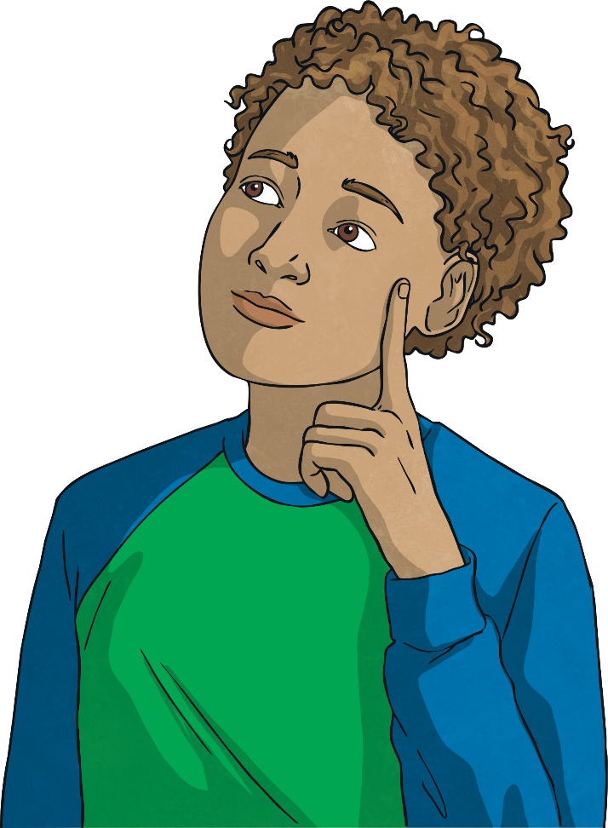
Fill choose the correct to complete this sentence.
heat
Thermal conductors allow ______ to move through them.
a. water
b. heat
c. air

Slide 10
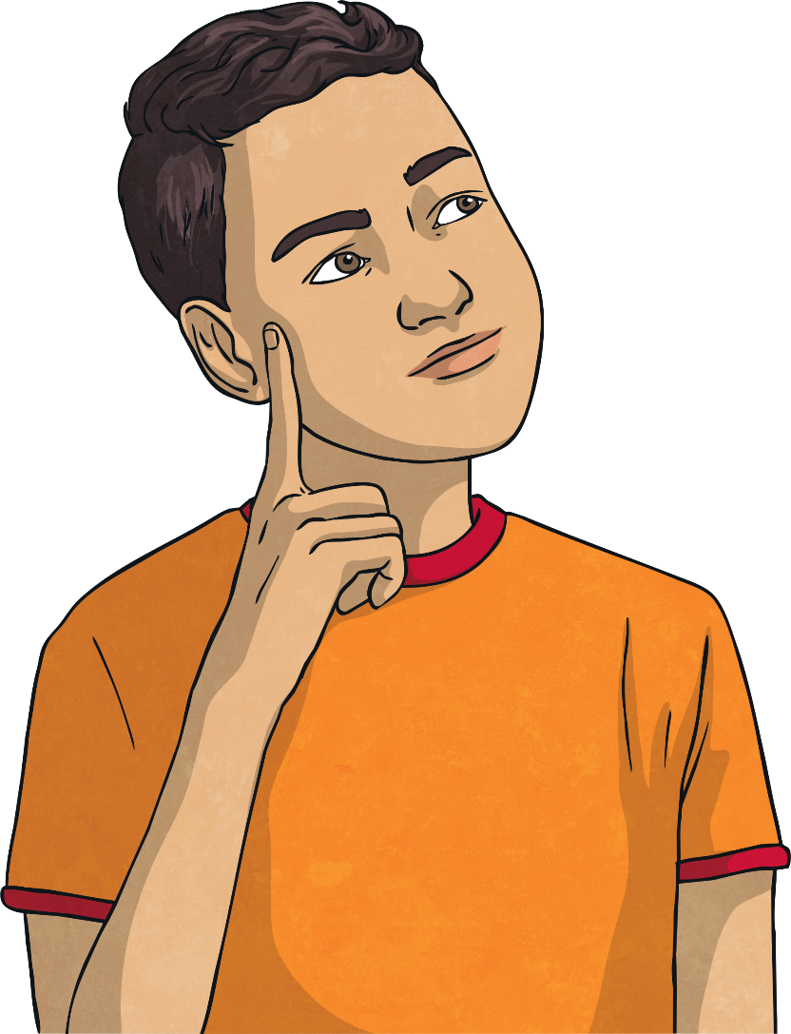
2. Plastic is a good thermal conductor.
True
False
Plastic is a good thermal insulator as it does not
allow heat to pass through it.
The handles of saucepans are often made from
plastic to protect your hand from the heat.

Slide 11
3. Which of these sentences is true?
a. Heat always travels to a warmer place.
b. Heat does not travel; it stays in one place.
c. Heat always travels from a warmer
place to a cooler one.
A hot cup of tea left in a cold place will lose heat until it is the same temperature as its surroundings.

Slide 12
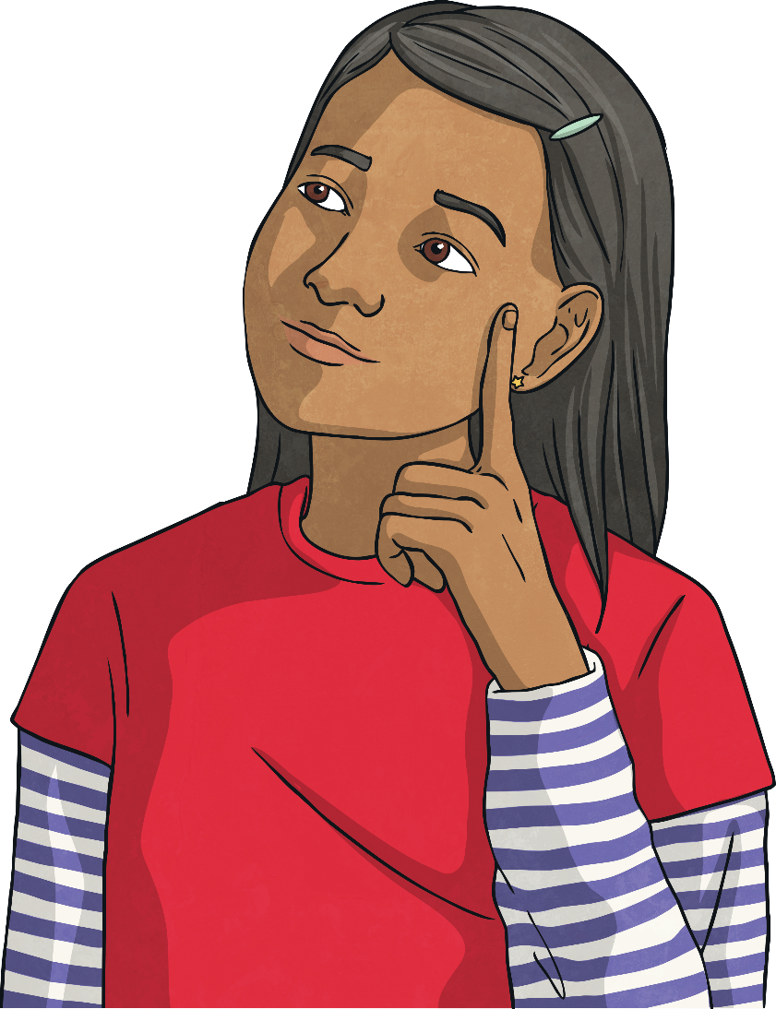
4. Why is a scarf a good thermal insulator?
A scarf is a good thermal insulator
because it stops the heat from your
body escaping into the cold air.

Slide 13
5. A wooden spoon is an example of a:
Explain your answer.
a. thermal conductor
b. thermal insulator
A wooden spoon is an example of a thermal insulator.
Wood does not allow heat to travel through it. Wooden spoons are used in cooking so that you do not burn your hand.

Slide 14
6. Metals are good thermal conductors.
b. True
Metals are very good thermal conductors. We use metals such as steel and aluminium to make objects that need to heat up quickly. For example, saucepans are made of metal so that we can heat and cook food effectively.
a. False

Slide 15
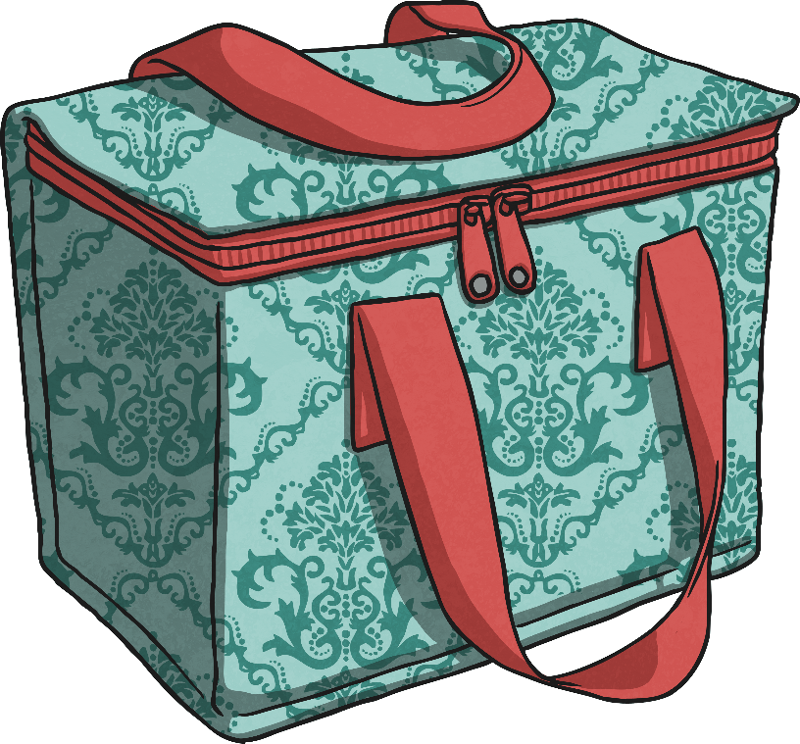
Design a New Lunch Box
The Brilliant Bags Company want to make a new lunch box for children to bring their packed lunches to school in.
Food will be stored in the lunch box for quite a long time – probably all morning.
They want to make sure the lunch box keeps the children’s lunches cool and fresh, so they need to think about the best material to use to make the inner lining of the lunch box.

Slide 16
Design a New Lunch Box
The company want you to help them choose the best material for the inner lining of the lunch box.
The lining will need to stop heat getting through from the air to the cool food inside.
Will the lining need to be a good thermal conductor or a good thermal insulator?
Conductor
Insulator
Incorrect!
Correct!

Slide 17
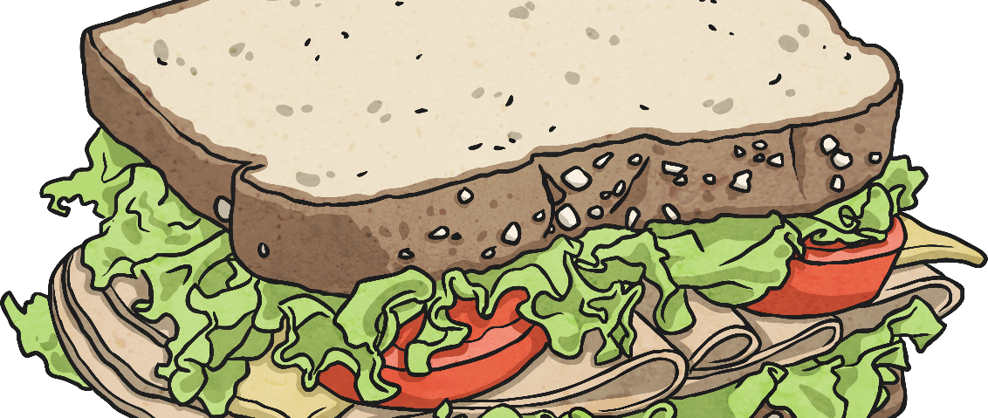
Design a New Lunch Box
You will need to find the best thermal insulator for the inner lining of the lunch box. Thermal conductors will let heat through and make the food warm up quickly.
Thermal insulators will stop the heat getting through and keep the food cool for longer. You will need to set up a comparative investigation to test the different materials to see if they conduct heat or insulate from it.

Slide 18
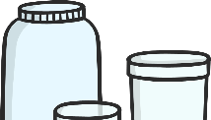
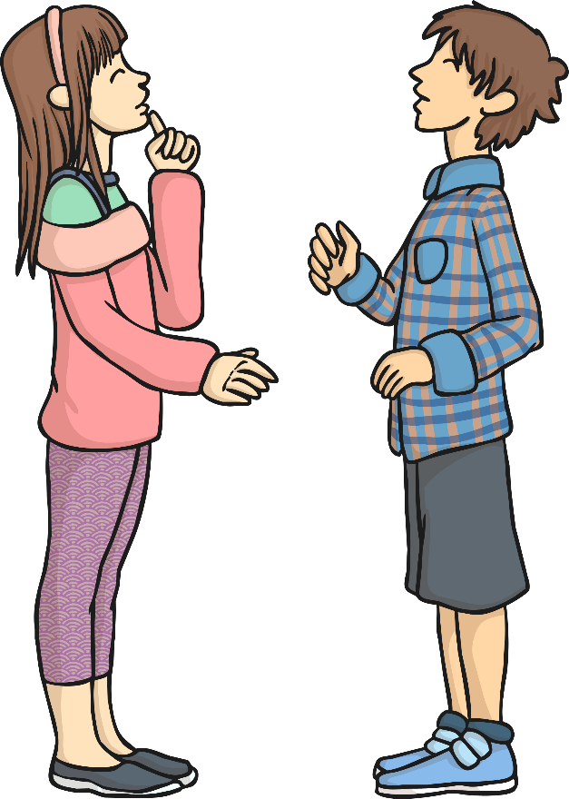
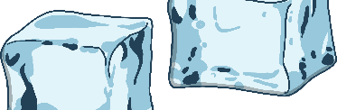
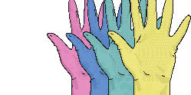
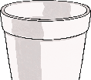
Testing Materials
Can you test the thermal conductivity of the different materials?
You can use the following equipment:
Talk to your partner about your ideas.
containers
thermometers
ice cubes
rulers
stopwatches
different materials

Slide 19
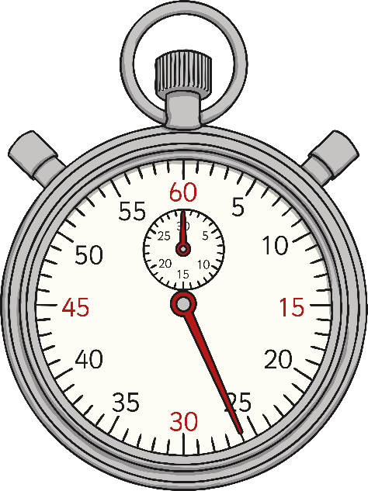
Testing Materials
You could wrap the different materials around the containers, and then fill them with the ice cubes.
Any material which stops heat from the outside getting through will keep the ice cubes solid for longer. These materials are thermal insulators.
By checking the temperature of the containers at intervals of time, you will be able to see which materials allow heat from the surroundings through easily. These materials will cause the ice to melt quicker. They are thermal conductors

Slide 20
Identifying the Variables
When setting up investigations, scientists have to consider the variables of each experiment. A variable is any factor or condition that will change or can be changed in the investigation.
There are three types of variables:
Independent
Dependent
Controlled
The independent variable is the thing that the scientist purposefully changes or alters throughout the investigation.
The dependent variable is the thing that is measured or observed, and changes as a result of the changes to the independent variable.
All the other things in the investigation should remain the same throughout, and are called controlled variables.

Slide 21
Identifying the Variables
Think about the variables for the investigation you are going to do today.
Talk to your partner about all the possible variables there are in this investigation into thermal conductors and insulators.
Some ideas include:
Type of container.
Type of thermometer.
Quantity of ice cubes.
Temperature of room.
Length of time.
Size of material.
Size of container.
Type of container.

Slide 22
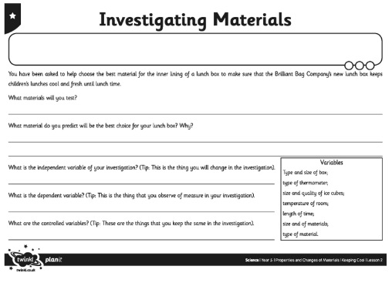
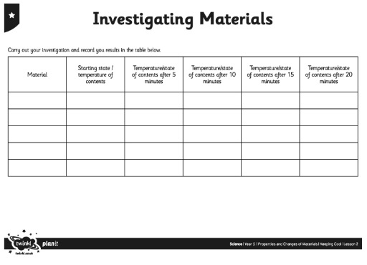
Investigate
Set up your investigation to find the best material for the lunch box.
Record your results on your Investigating Materials Activity Sheet.

Slide 23
Aim
I can investigate thermal conductors and insulators.
Success Criteria
I can identify materials that are thermal conductors and insulators.
I can explain what thermal conductors and insulators are.
I can plan and carry out an investigation into thermal conductors and insulators.
I can give reasons for the uses of thermal conductors and insulators.

