Slide 1
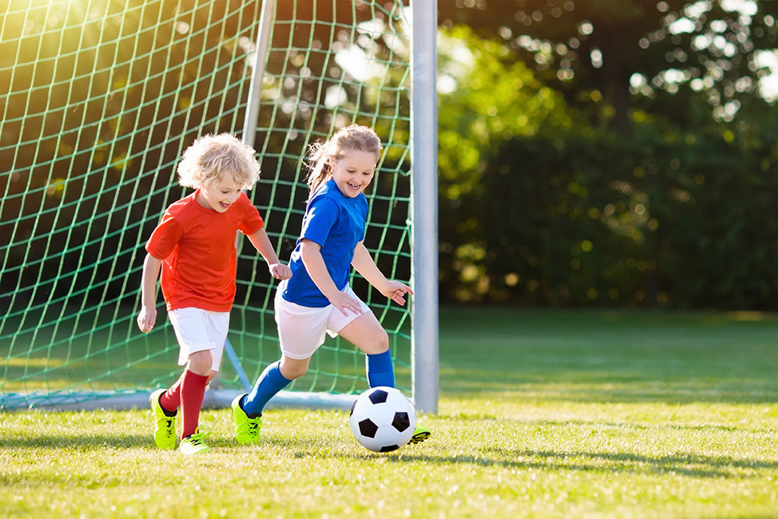
What am I good at?

Slide 2
What am I good at?

Slide 3
What am I good at?

Slide 4
What am I good at?

Slide 5
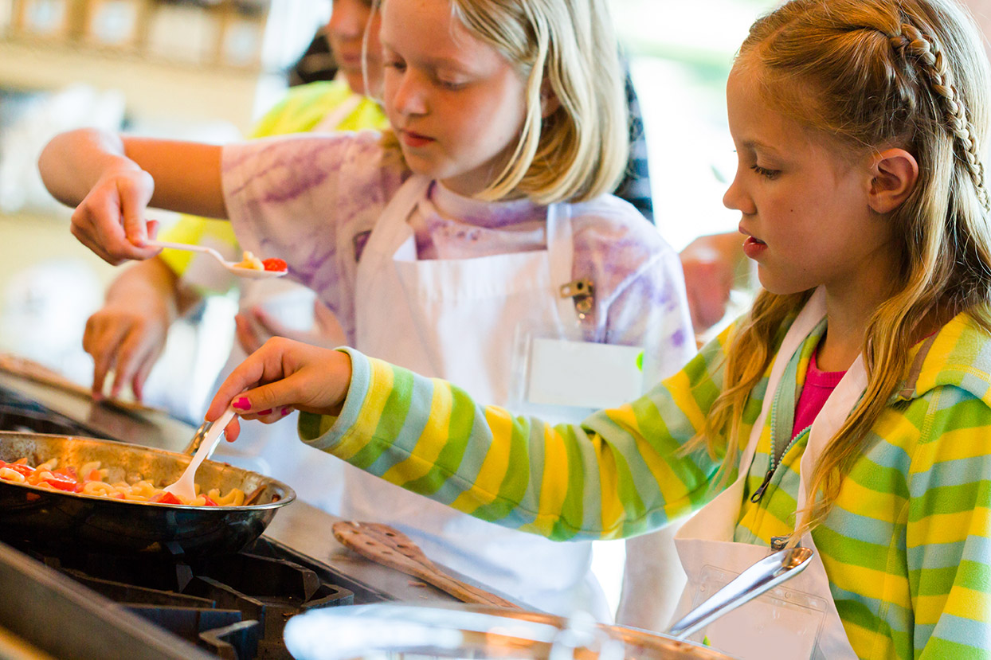
What am I good at?

