Slide 1
Jewish Artefacts

Slide 2
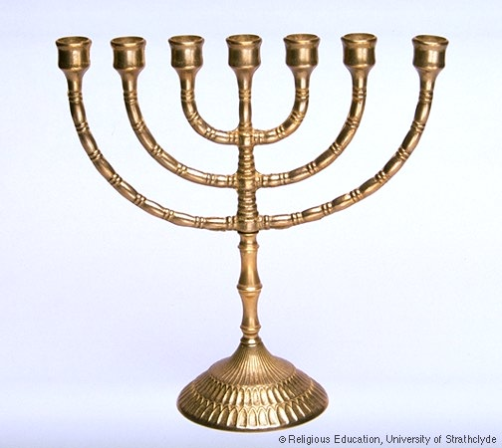
The Menorah
One of the oldest Jewish symbols.
Candle holder.
It is lit every evening and cleaned out every morning to replace the wicks and to put fresh oil in.

Slide 3
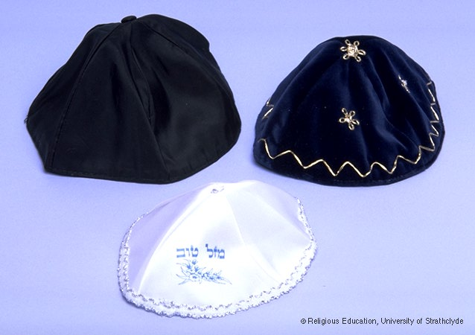
Skull caps – Kippah
Most Jews will cover their heads when praying, attending the synagogue or at a religious event or festival.
The most common reason (for covering the head) is a sign of respect and fear of God. It is also felt that this separates God and human, by wearing a hat you are recognising that God is above all mankind.

Slide 4
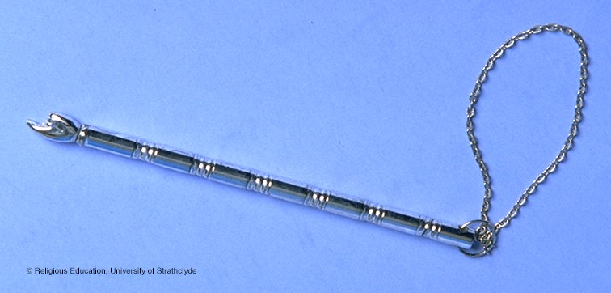
Yad
This is a pointer which is used when the Torah is being read.

Slide 5
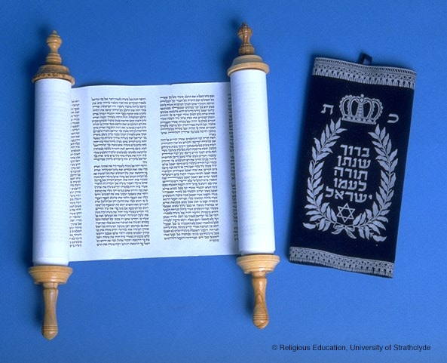
Torah
The Torah is the first part of the Jewish bible. It is the central and most important document of Judaism and has been used by Jews through the ages.
The Torah is written in Hebrew, the oldest of Jewish languages.
Read in the synagogue three times each week

Slide 6
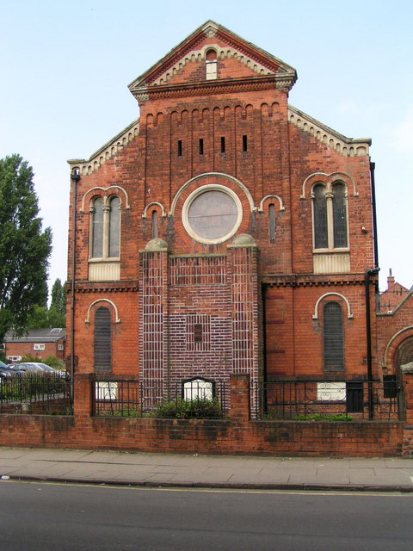
The synagogue is the Jewish place of worship
Synagogue services can be led by a rabbi
Jewish men always wear hats when they are saying prayers which mention God's name
Hats are always available for visitors, but a hair grip comes in handy to keep a kippah on.

Slide 7
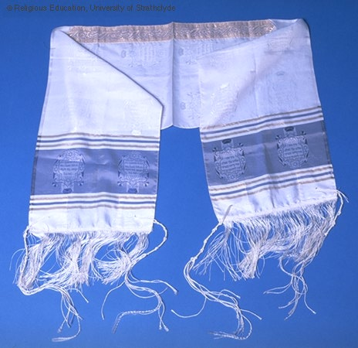
Tallit
A prayer shawl worn by men and women.
On each of the four corners of the Tallit are special knots called Tassels
The Tallit must be long enough to be worn over the shoulders

Slide 8
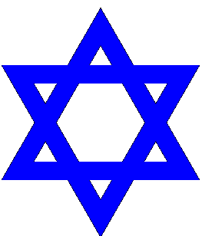
The star of David
The Jewish religious symbol

