Slide 1


Science
Properties and Changes of Materials
Year One
Science | Year 5 | Properties and Changes of Materials | Dissolving | Lesson 4

Slide 2


Slide 3
Aim
I can investigate materials which will dissolve.
Success Criteria
I can describe dissolving.
I can explain the difference between melting and dissolving.
I can identify materials which will dissolve in water.
I can investigate factors which affect the speed of dissolving.

Slide 4




Disappearing Act
These children have put some sugar cubes into a cup of tea. They watch as the sugar cubes seem to disappear. What has happened to them?
Talk to your partner about who you agree with.
The sugar particles have mixed with the water to make a see-through solution. The sugar cubes have dissolved.
The sugar cubes heated up in the cup of tea, which caused them to melt. They have changed state from a solid to a liquid
The particles of sugar in the sugar cubes heated up so much that they evaporated. They are in the air now.

Slide 5
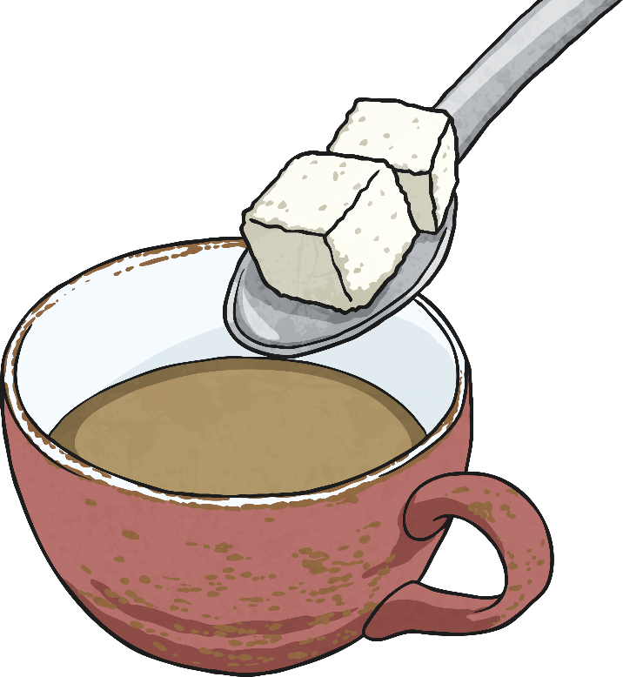
Disappearing Act
Did you agree with this girl?
She is correct! The sugar has dissolved in the tea.
Dissolving occurs when the particles of certain solids mix with the particles of certain liquids.
When a material dissolves, it looks like it disappears. But it has actually just dissolved in the liquid to make a transparent solution. A solution is formed when a solid dissolves in a liquid.
Not all solids will dissolve, and not all liquids will allow solids to dissolve.
When you mix sugar with water, the sugar dissolves to make a transparent solution.
The sugar particles have mixed with the water to make a see-through solution. The sugar cubes have dissolved.

Slide 6
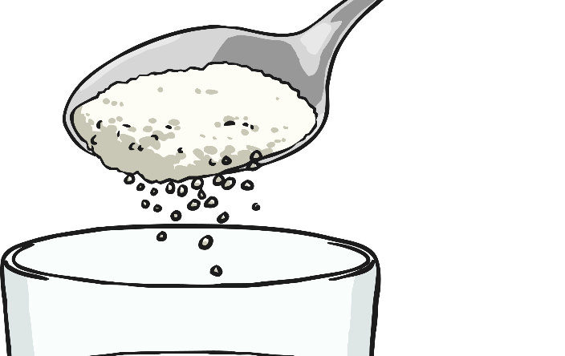
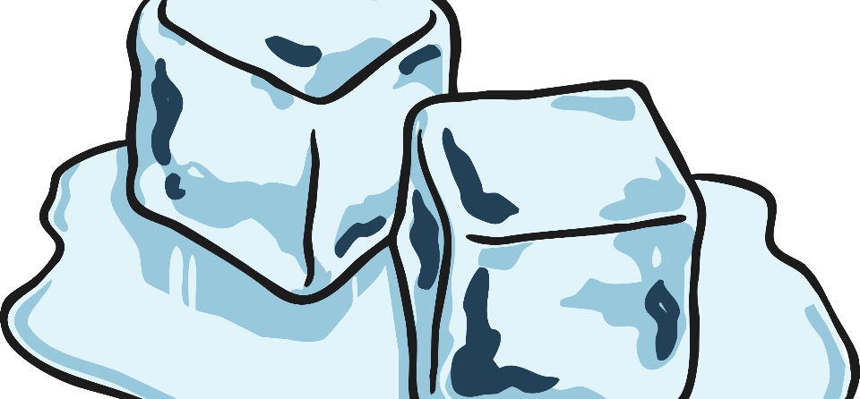
Dissolving or Melting?
Many people get confused between dissolving and melting, but there are several important differences:
Dissolving
Dissolving involves a liquid and another material, often a solid.
In dissolving, the solid mixes into the liquid to make a new liquid, called a solution.
Dissolving doesn't need heat to occur.
Melting
Melting involves only a solid.
In melting, the solid changes into a liquid that is the same material.
Melting needs heat to occur.

Slide 7

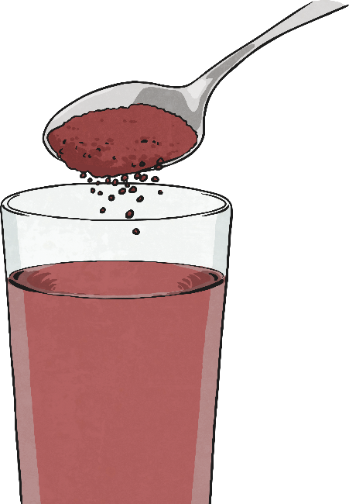
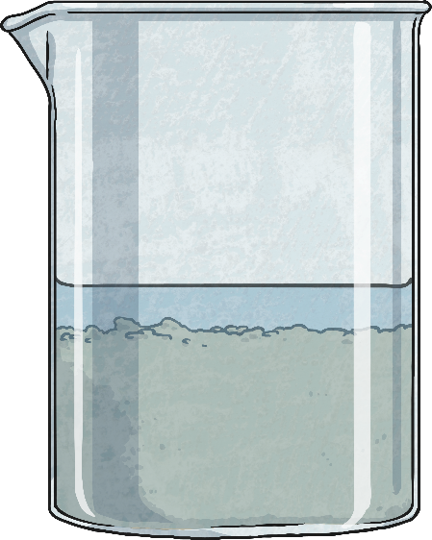
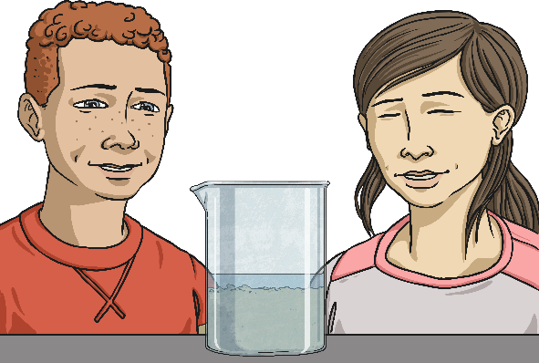
Soluble or Insoluble?
Materials that will dissolve are known as soluble.
Materials that won't dissolve are insoluble.
You are going to work in pairs to find out which materials are soluble and which are insoluble.
Mix a teaspoonful of each material with 50ml of water.
If the material does dissolve, the water will be transparent. It may have changed colour but will be see through. You will not see the particles of solid any more.
If the material does not dissolve, you will still see the particles of the solid in the water.

Slide 8

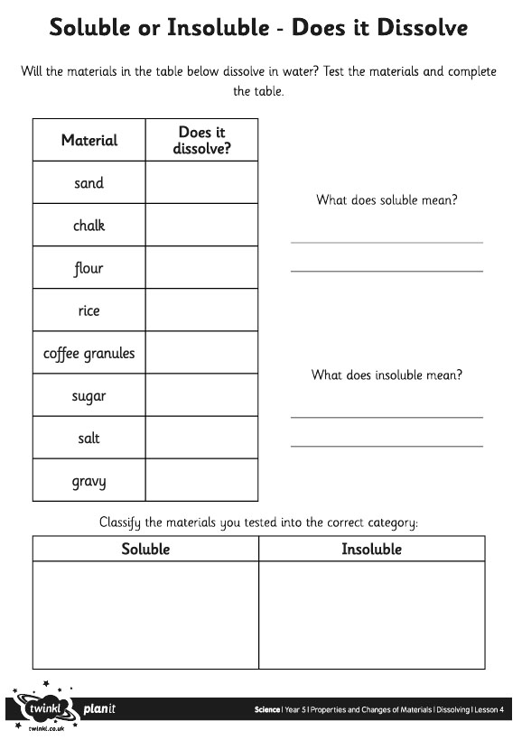
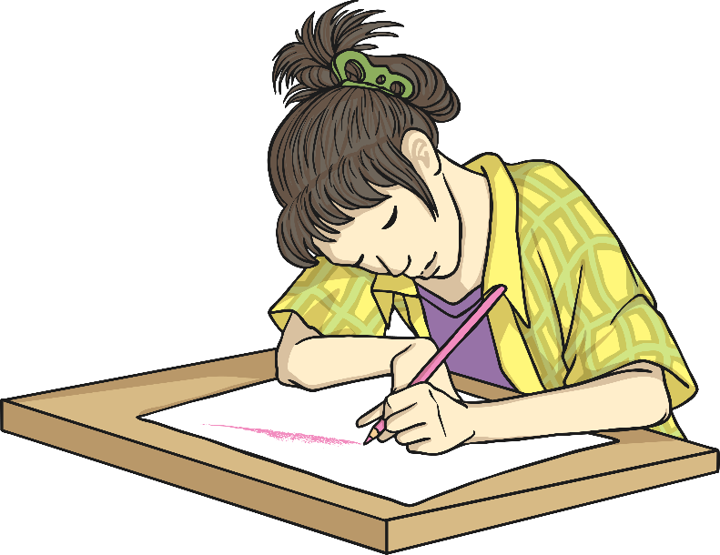
Soluble or Insoluble?
Complete your Soluble or Insoluble Activity Sheet to record whether the different materials will dissolve in water.

Slide 9

Investigating Dissolving
You are going to work in pairs to investigate dissolving.
You will need to consider the possible variables that might affect dissolving, then think of a question to ask about one of these variables. Talk to your partner about the possible variables.

Slide 10

Investigating Dissolving
Click on the speech bubbles to reveal some possible variables.
Number of stirs
?
?
Type of container
?
Mass of material
Type of water
?
?
Water temperature
Speed of stirs
How many of these variables did you think of? Did you think of any others?
?
?
?
Time to dissolve
Particle size
Time stirred
?

Slide 11
Investigating Dissolving
Now you need to decide on the question you are going to investigate.
Look at the variables, and choose your independent variable (the thing you will change) and your dependent variable (the thing that is affected by the independent variable, and the thing you will observe or measure).
Use these variables to form your question.
All the other variables should be the controlled variables, and should stay the same.
Record your choices on your on your Dissolving Investigation Activity Booklet.
Number of stirs
Mass of material
Type of water
Type of container
Speed of stirs
Time to dissolve
Particle size
Time stirred
Water temperature

Slide 12
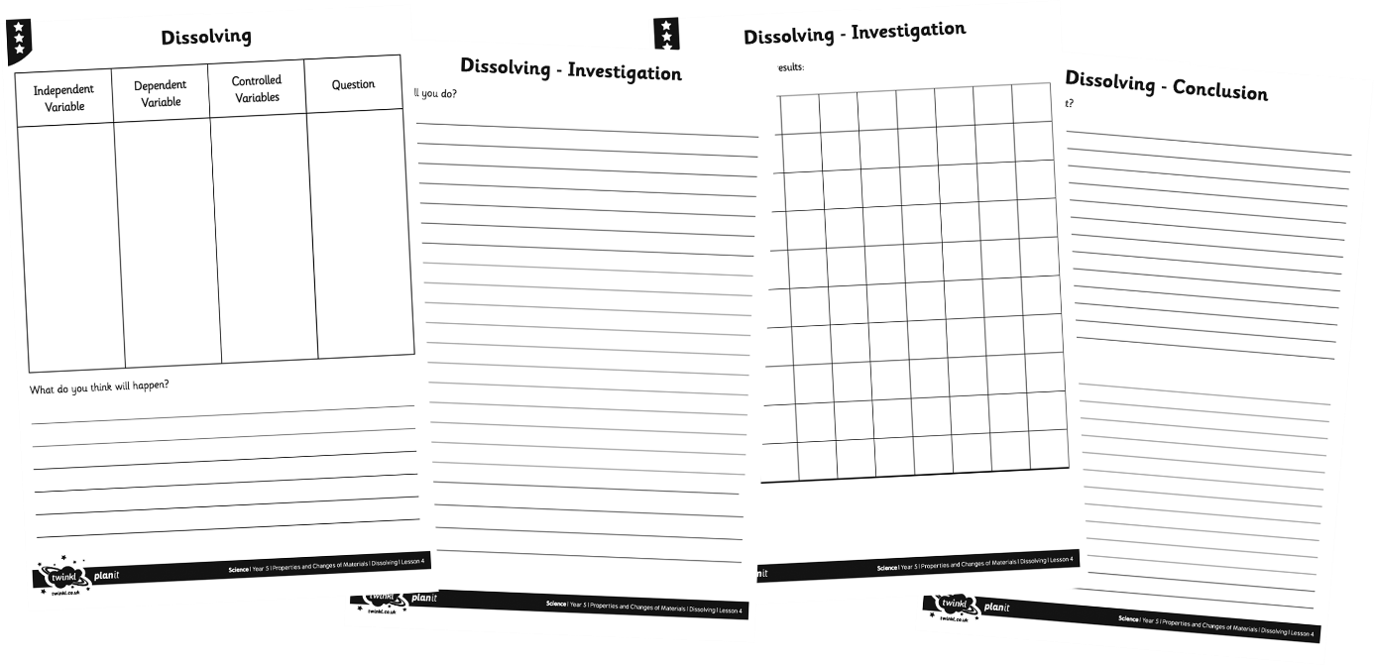
Investigating Dissolving
Use your Dissolving Investigation Activity Booklet to make a prediction and describe your investigation.

Slide 13
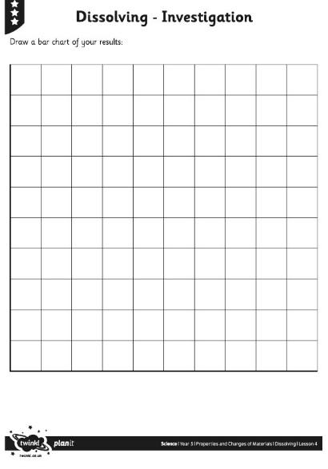
Find the Answer
Investigate it!
Record your results in a bar chart on the axes provided.
Use your results to make your conclusion.

Slide 14


Share Your Findings
Speak to someone in your class who investigated a different question to you.
What did they find out? Tell them what you found out.
Now speak to someone who investigated the same question as you. Did they find the same answer as you? Can you think why or why not?

Slide 15

Aim
I can investigate materials which will dissolve.
Success Criteria
I can describe dissolving.
I can explain the difference between melting and dissolving.
I can identify materials which will dissolve in water.
I can investigate factors which affect the speed of dissolving.

