Slide 1
Thursday 4th of June 2020
WALT:
To develop an awareness of the lives of significant individuals in the past who have contributed to national and international achievements.

Slide 2
New Topic Guessing Game
For our lesson today, we are going to be learning something new.
Before you find out, can you watch the video below and then guess what we are learning about.
https://www.youtube.com/watch?v=C7OJvv4LG9M
What do you think today’s lesson will be about?
Go to the next slide to find out.

Slide 3
We are learning about the History of Flight
What were the people trying to do in the video?
Did it look amusing?
Did it look easy or difficult?
If you lived long ago, before aeroplanes were invented, how would you fly?
Remember, this was a time before engines, power supplies and man-made materials. Talk to and adult at home about this.
Parents/Carers: Encourage a discussion and find out what your child already knows about this topic.

Slide 4
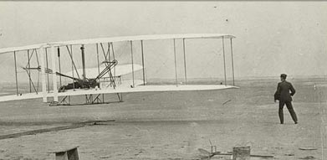
Designing an aeroplane
There was a time when human beings were not able to fly in the air. The aeroplane was not invented yet and although some tried, they were unable to invent a suitable aeroplane that could actually fly.
This was over 100 years ago. The first working aeroplane that worked was invented almost 120 years ago.
If you lived before that time and wanted to invent an aeroplane. What materials would you use?
Can you they to make a model at home?
Maybe you can draw a design at home. Would it look any different to the ones we see now?

Slide 5
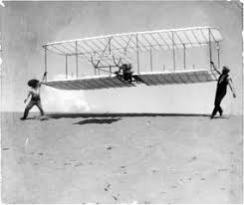
The Wright Brothers
A long time ago, Wilbur and Orville Wright actually did fly, on December 17, 1903, they succeeded in flying the first power driven aeroplane.
Next week, you will find out more about these pioneering brothers.

