Slide 1
English 13.07.20
Charlie Cook’s Favourite Book
Day 1

Slide 2
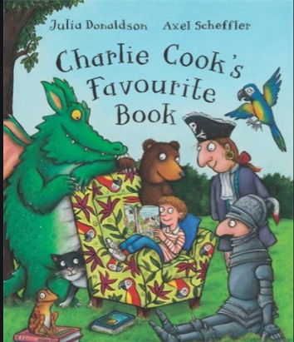
This week we are using Julia Donaldson’s Charlie Cook’s Favourite Book as our topic for English.
Can you listen to the story here: https://www.youtube.com/watch?v=RoqD0YpL3S4

Slide 3
Charlie Cook’s Favourite Book, each character has a favourite book.
What is your favourite book?
Can you write a brief description about your book and why you like it? Remember to use the word because when explaining why you like it.
What is your favourite part? Which part don’t you like?

Slide 4
English 14.07.20
Charlie Cook’s Favourite Book
Day 2

Slide 5
Alliteration
Charlie Cook’s name has an alliteration.
Alliteration is when words start with the same sound
Some examples are: Sally Smith, Harry Hopkins, Captain Crook?
Can you think of other names that have alliteration.
Make a list with as many alliterative names you can think of.

Slide 6
English 15.07.20
Charlie Cook’s Favourite Book
Day 3

Slide 7
Purposes of Texts
In Charlie Cook’s Favourite Book, we come across lots of different types of text.
Can you listen to the story again and recognise which part has a magazine, a comic, an encyclopaedia and a story book?
Describe the different types of books featured in the story.
How are they similar / different?

Slide 8
English 16.07.20
Charlie Cook’s Favourite Book
Day 4

Slide 9
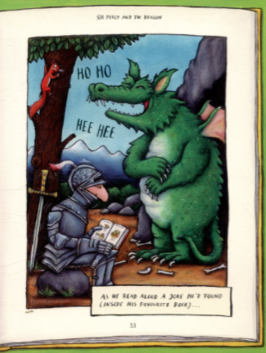
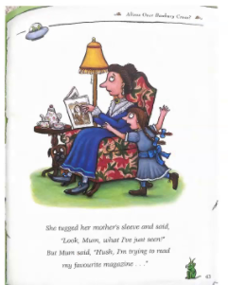
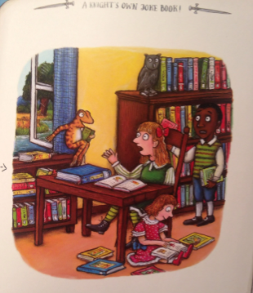
In Charlie Cook’s Favourite Book, we meet different people in different stories.
Which one of the books in this story is your favourite?
Can you explain why?

Slide 10
English 17.07.20
Charlie Cook’s Favourite Book
Day 5

Slide 11
Yesterday you chose a story in Charlie Cook’s Favourite Book that was your favourite.
Can you create a longer version of that story, making sure that it has a beginning middle and an end. Remember your capital letters, full stops, finger spaces and amazing adjectives!

