Slide 1


Top 10 Tips for a Sustainable Christmas
Hertfordshire County Council
Hertfordshire County Council

Slide 2
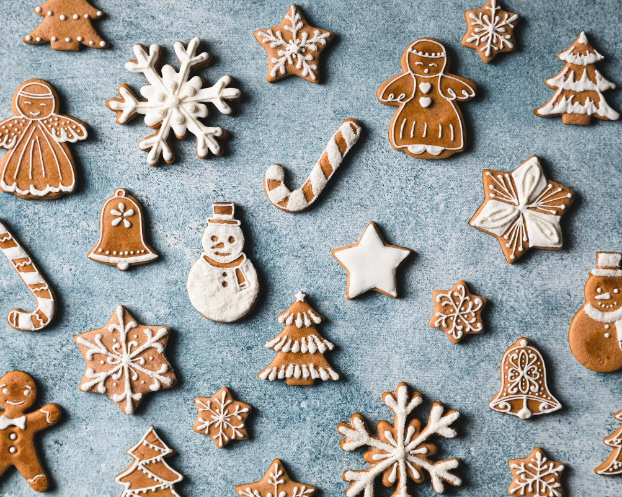
Top 10 Tips for a Sustainable Christmas
Christmas is fast approaching, and it is a
wonderful time of the year full of joy and celebration.
However, it is also the time of the year that the UK generates more waste than ever. At this time of year around 30% more waste is generated, including over 1 billion Christmas cards which are thrown away each year.
Therefore, we wanted to share with you our Top 10 Tips for a Sustainable Christmas. It's snow secret that we all want a greener Christmas. Here yule find lots of hints and tips on how we can all work together to create a more sustainable Christmas, and one which reduces our environmental impact and is kinder to the planet.
Hertfordshire County Council

Slide 3
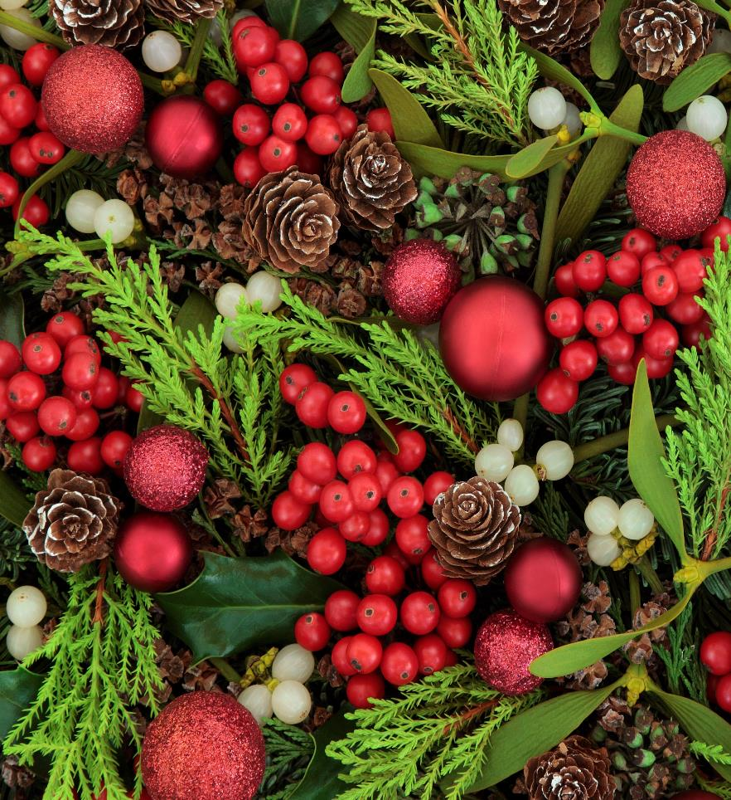
1. Make your own Christmas decorations
Each Christmas, approximately 12,500 tones of Christmas decorations are discarded into landfill.
Many plastic decorations cannot be recycled due to the glue and glitter on them.
Why not make your own decorations and/or use natural materials such as dried fruits, pinecones or even recycled paper. You could even make edible decorations!
When buying new decorations, look for those made from sustainable materials such as glass and wood.
More festive tips:
  8 easy hacks to make Christmas more sustainable this year – Bower Collective
Hertfordshire County Council

Slide 4

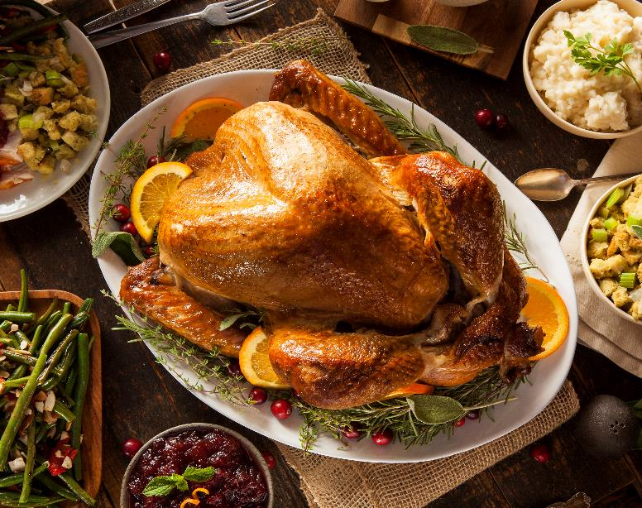
2. Reduce festive food waste
Most of this food waste ends up in landfill, thereby creating methane and other greenhouse gases as it decomposes.
Reduce your food waste by planning your Christmas menu carefully. Think about portion sizes and using seasonal and locally grown ingredients which have a lower carbon footprint.
Dispose of any leftover food in a food waste collection and/or compost it, instead of sending to landfill.
More festive tips:
      Sustainable Christmas | Soil Association
      Christmas Leftovers Recipes | Good Food
Every Christmas, millions of tonnes of food
are wasted, including approximately 5 million puddings, 2 million turkeys and 74 million mince pies.
Hertfordshire County Council

Slide 5

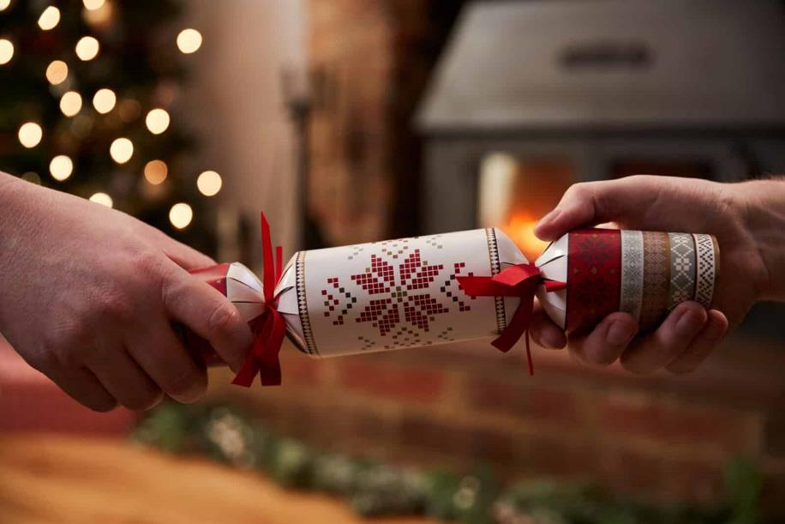
3. Going crackers for a sustainable Christmas
Crackers contain excess plastic packaging, along with a large amount of single use plastic ‘toys’.
Each year, more than 100 million crackers get thrown away. Many of these cannot be recycled and end up in landfill.
Why not consider plastic-free crackers? Look out for the forestry logo on the packaging to recognise sustainable sourcing of materials.
You could also try making your own sustainable Christmas crackers and fill them with home-made paper hats and plastic-free gifts! Don’t forget to include a tree-mendously funny joke in each cracker too!
More festive tips:
  Eco-Friendly Christmas Crackers | Love Your Footprints
  Christmas Cracker Kit (set of 6) | Planet Friendly Living
Hertfordshire County Council

Slide 6

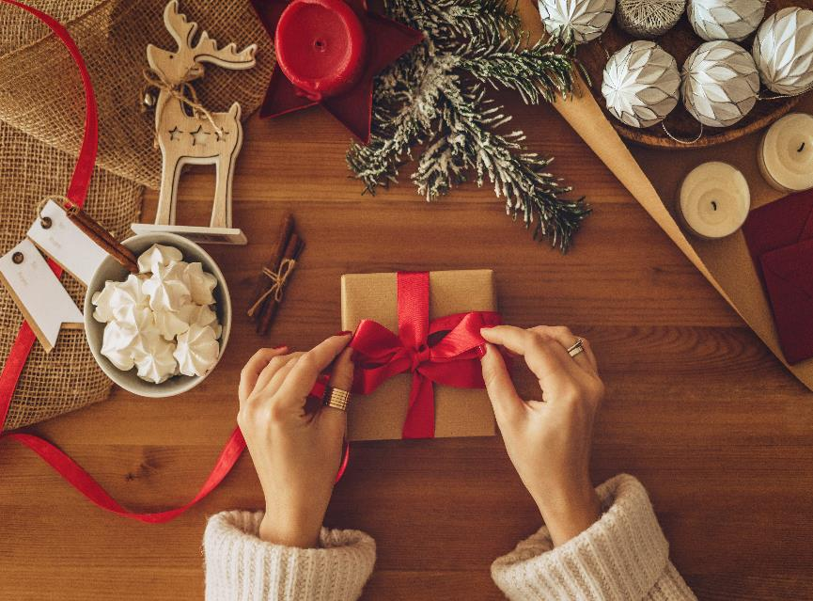

4. Sustainable gifting
The manufacture and transportation of products also create greenhouse gas emissions.
Why not consider sustainable gifting by:
Giving fewer gifts that are more meaningful.
Choosing items that are useful, or experiences, rather than material gifts.
Thinking about the materials used – avoid single-use plastics, look for organic food and clothing.
Why not consider pre-loved gifts?
More festive tips:
    Top tips for a sustainable Christmas | WWF
Giving gifts is a key Christmas tradition but can also lead to over-consumption and waste.

Slide 7
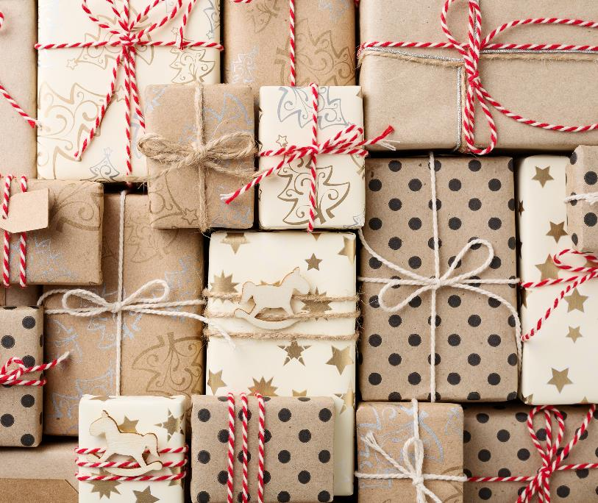


4. Go green with your gift wrap
5. Greening your gift wrap
Each year, wrapping paper is often used only once, and approximately 200,000 miles of gift wrap is thrown away.
Furthermore, Sellotape and ribbon cannot be recycled.
Ribbon also contains harmful synthetics.
Why not try using the following alternatives for wrapping:
Fabric wraps (e.g. furoshiki - Japanese wrapping cloth).
Foil-free and glitter-free paper, brown kraft paper or old newspaper, all of which can be recycled.
Natural decorations, such as twine, dried flowers, compostable brown tape and/or compostable garden twine.
Avoid gift tags and write names on the presents instead.
More festive tips:
  15 Eco-Friendly and Zero-Waste Gift Wrapping Ideas - Mindful of the Home
Hertfordshire County Council

Slide 8

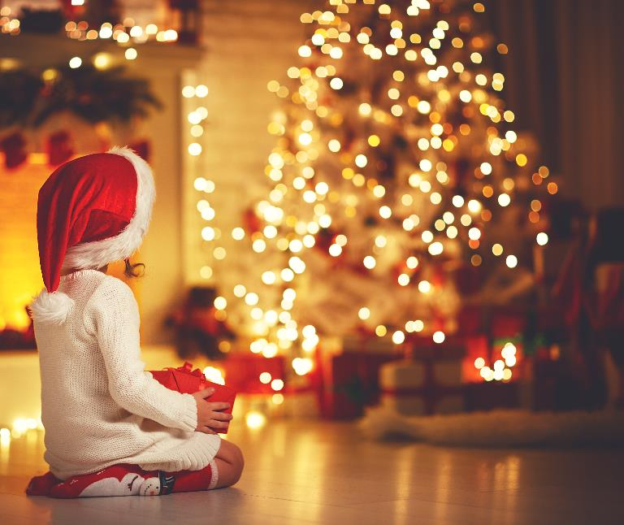
6. Lighting the way to sustainability
When selecting Christmas lights try to use LED lights as they use less energy and last longer.
Choose lights that are powered by a plug rather than batteries.
When using batteries, use rechargeable batteries rather than buying new batteries each time.
Make sure that Christmas lights are turned off at night. Not only is this much safer for you, but it will also save you money and electricity.
More festive tips:
    Top tips for a sustainable Christmas | WWF
Hertfordshire County Council

Slide 9
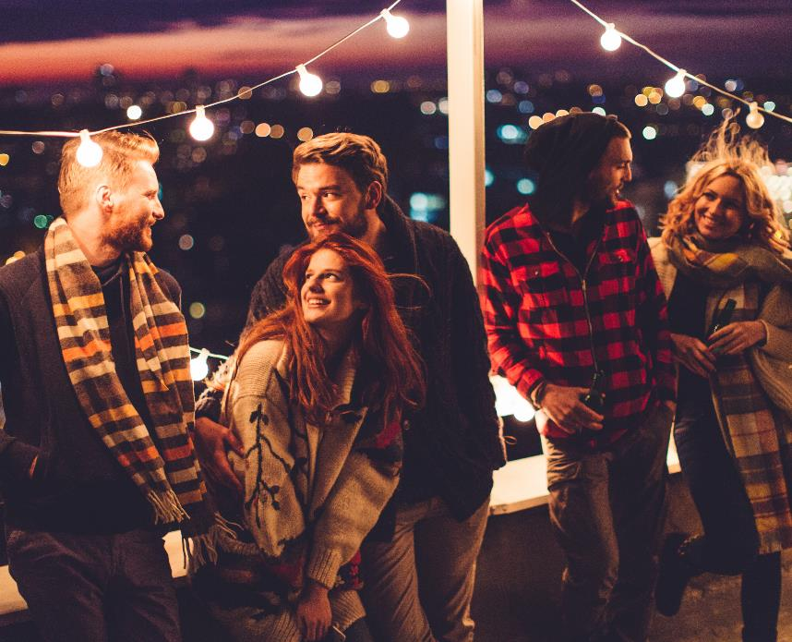

7. Dress to impress, both stylishly and sustainably
6. Light the way in being sustainable
This party season we know you want to dress to impress! But when selecting your party outfits, choose sustainably.
Choose pre-loved clothing from second hand shops and/or clothing apps or borrow from your friends and family!
Why not donate an old item for someone else to find or try to sell some items.
Remember … You definitely CAN wear the same thing twice!
More festive tips:
  Top tips for a sustainable Christmas | WWF
Hertfordshire County Council

Slide 10


Insert title text here
8. Christmas cards, cards and more cards
6. Light the way in being sustainable
Did you know that in the UK, over one billion Christmas cards are thrown away every year.
In the UK, each person sends and receives an average of 17 Christmas cards. However, around 75% of these cards are usually not recycled and end up in landfill.
Why not send your loved ones cards that can be recycled or reused.
You can also send E-cards rather than paper cards.
Plantable cards are a great way of helping the environment and not contributing to landfill.
More festive tips:
    Christmas Waste Facts: Reduce, Reuse, Recycle This Holiday Season
Hertfordshire County Council

Slide 11
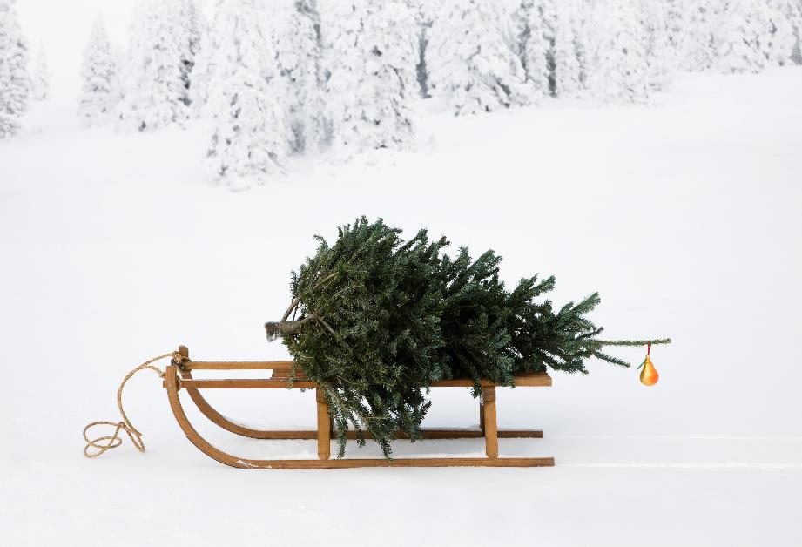

Insert title text here
9. The perfect Christmas tree
6. Light the way in being sustainable
There are many options for Christmas trees, some more sustainable than others.
An artificial Christmas tree is only sustainable if it has a life span exceeding 10 years. They are usually made from plastic or PVC, which are non-biodegradable and often have a larger carbon footprint than real trees due to the manufacturing process.
Locally sourced real Christmas trees are 100% recyclable and biodegradable. If purchasing a real tree, then make sure it is a Forest Stewardship Council (FSC®) certified tree.
Why not consider a wooden Christmas tree to add something unique and sustainable to your home.
More festive tips:
  Choose a sustainable Christmas tree | Soil Association
Hertfordshire County Council

Slide 12
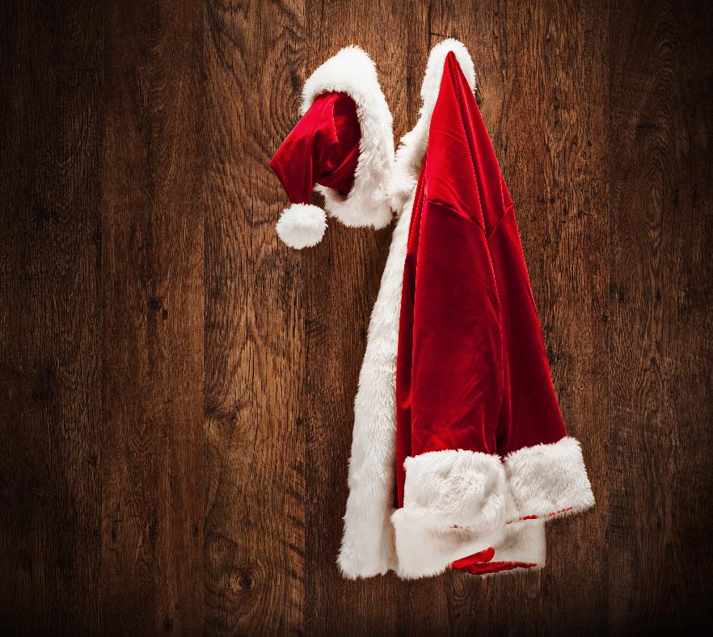

Insert title text here
10. Sustainable Secret Santa
6. Light the way in being sustainable
Secret Santa is great fun and is a great way to save money and the environment.
Setting a budget for Secret Santa helps buyers be precise and think of useful gifts.
Try and source gifts in recycled packaging, or gifts that have a long lifespan.
You could also consider pre-loved or second-hand gifts too.
More festive tips:
  Sustainable Christmas - Secret Santa | Plastic Free and Sustainable Living Blog
Hertfordshire County Council

Slide 13

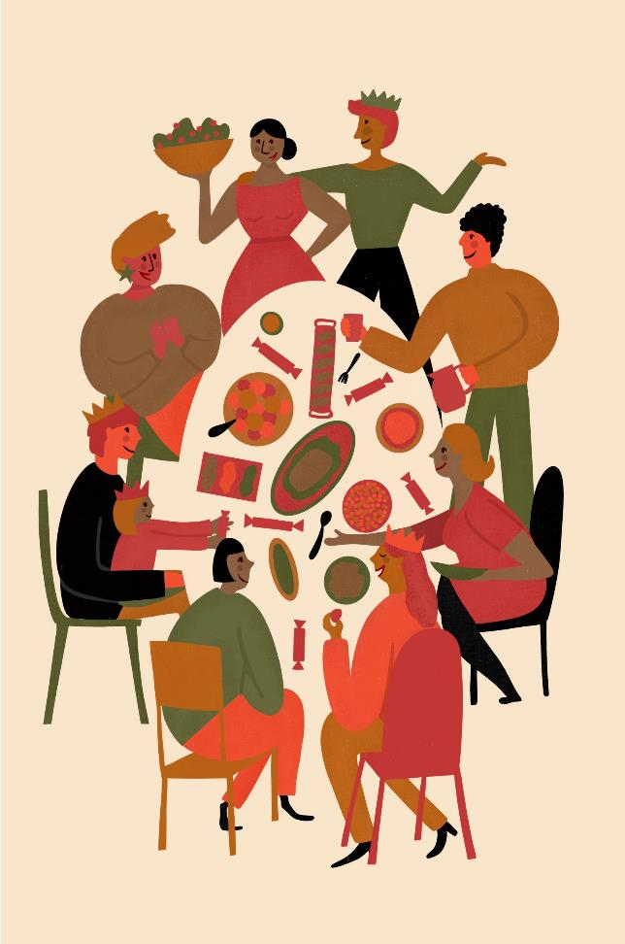
Insert title text here
Season the Day! There’s snow better time to talk about these Top 10 Tips!
Merry Christmas!
6. Light the way in being sustainable
Use the festive season as an opportunity to talk and share ideas with
friends and family about how everyone can contribute towards making
Christmas more sustainable.
Why not share each of these Top 10 Tips for a Sustainable Christmas
with your family and friends and encourage everyone to adopt one or
more of these sustainability actions.
No action is too small. If we all play our part, then we can create a
sustainable Christmas, which is kinder to our planet. Let’s continue the
sustainability journey all year round too.
Why not watch The Good Life - Silly, but Its Fun - BBC iPlayer for
inspiration on how a low cost and sustainable Christmas can still be merry and fun!
Hertfordshire County Council

Slide 14


